Slide 1
CS217 – Object Oriented Programming (OOP)
Week – 09
April 05-09, 2021
Instructor: Basit Ali

Slide 2
Recap – Inheritance
Derived class inherits all the characteristics of the base class
Besides inherited characteristics, derived class may have its own unique characteristics
Major benefit of inheritance is reuse

Slide 3
Generalization
In OO models, some classes may have common characteristics.
We extract these features into a new class and inherit original classes from this new class.
This concept is known as Generalization.

Slide 4
Example – Generalization
Line
Circle
Triangle
color
vertices
length
color
vertices
radius
color
vertices
angle
move
setColor
getLength
move
setColor
computeArea
move
setColor
computeArea

Slide 5
Shape
color
vertices
move
setColor
Triangle
Circle
radius
Line
angle
computeArea
length
computeArea
getLength

Slide 6
Polymorphism
The process of representing one Form in multiple forms is known as Polymorphism
Polymorphism is derived from 2 Greek words: poly and morphs. The word "poly" means many and morphs means forms. So polymorphism means many forms.

Slide 7
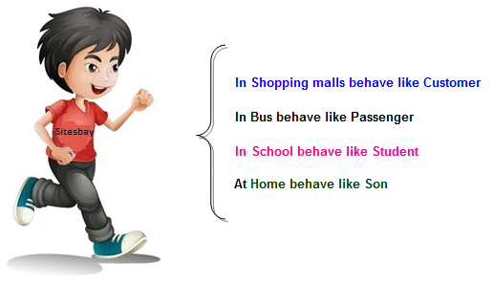
Real life example of Polymorphism
Suppose if you are in class room that time you behave like a student, when you are in market at that time you behave like a customer, when you at your home at that time you behave like a son or daughter, Here one person have different-different behaviors.

Slide 8
Type of Polymorphism
Static / Compile time polymorphism
Dynamic / Run time polymorphism

Slide 9
Static / Compile time polymorphism
It is also called Early Binding.
It happens where more than one methods share the same name with different parameters or signatures and different return type (not necessary).
It is known as Early Binding because the compiler is aware of the functions with same name and also which overloaded function is to be called is known as compile time.

Slide 10
Function/Method Overloading
Whenever same method (function) name is exiting multiple times in the same class with different number of parameter or different order of parameters or different types of parameters is known as method overloading.

Slide 11
Static / Compile time polymorphism
Overloading
Function Overloading (ALREADY DISCUSSED)
Constructor Overloading (ALREADY DISCUSSED)
Operator Overloading (TO BE DISCUSSED)

Slide 12
Dynamic / Run time polymorphism
This refers to the entity which changes its form depending on circumstances at runtime. This concept can be adopted as analogous to a chameleon changing its color at the sight of an approaching object.
Method Overriding uses runtime Polymorphism.
It is also called Late Binding.

Slide 13
Dynamic / Run time polymorphism
Runtime Polymorphism is done using virtual and inheritance.
When overriding a method, the behavior of the method is changed for the derived class.

Slide 14
Overriding
A class may need to override the default behavior provided by its base class
Reasons for overriding
Provide behavior specific to a derived class
Extend the default behavior
Restrict the default behavior
Improve performance

Slide 15
Function/Method Overriding
Define any method in both base class and derived class with same name, same parameters or signature, this concept is known as method overriding.

Slide 16
Example – Specific Behavior
color
vertices
draw
move
setColor
Triangle
Circle
radius
Line
angle
draw
computeArea
length
draw
computeArea
draw

Slide 17
Example – Improve Performance
Shape
color
coord
Class Circle overrides rotate operation of class Shape with a Null operation.
draw
rotate
setColor
Circle
radius
draw
rotate

Slide 18
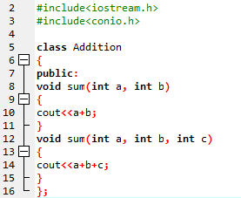
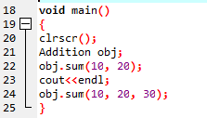
Example
Output:
30
60

Slide 19
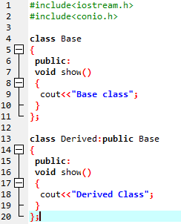
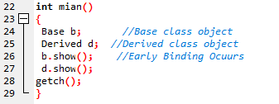
Example
Output:
Base class
Derived class

Slide 20
Hybrid Inheritance: Potential problem
common dangerous pattern: "The Diamond"
Classes B and C extend A
Class D extends A and B
Class D extends A and C
A
B
C
D

Slide 21
Problems with Hybrid Inheritance
Increased complexity
Reduced understanding
Duplicate features

Slide 22
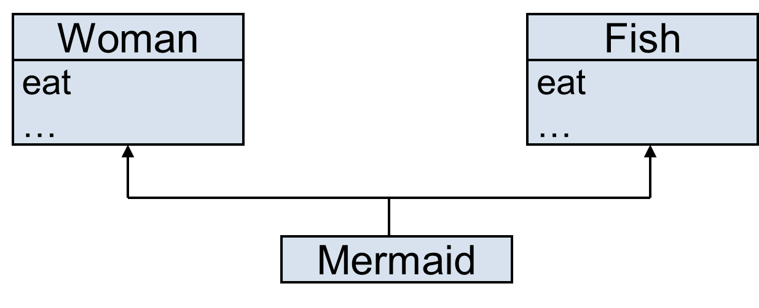
Problem – Duplicate Features
Which eat operation Mermaid inherits?

Slide 23
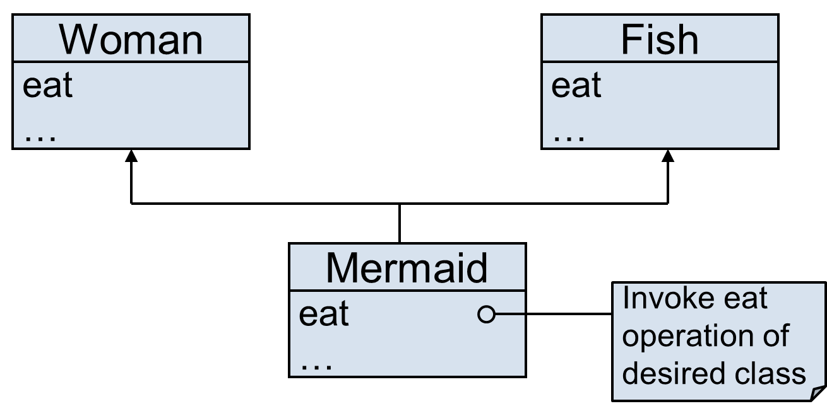
Solution – Override the Common Feature

Slide 24
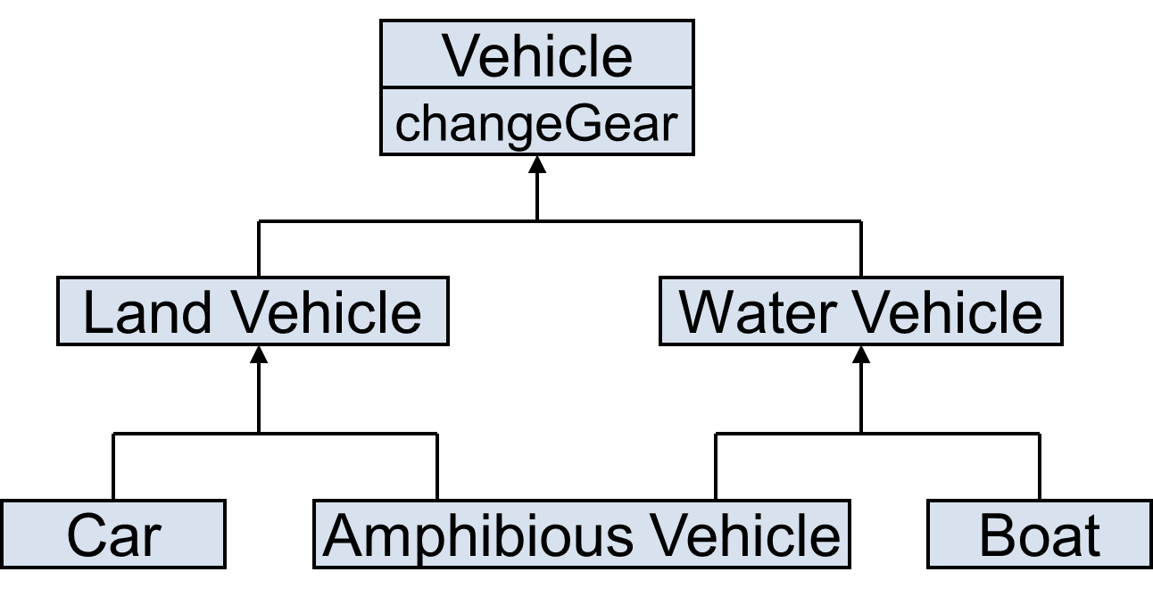
Problem – Duplicate Features (Diamond Problem)
Which changeGear operation Amphibious Vehicle inherits?

Slide 25
Solution to Diamond Problem
Some languages disallow diamond hierarchy
Others provide mechanism to ignore characteristics from one side

Slide 26


Solution to Diamond Problem (Virtual Inheritance)
What happens without virtual inheritance:
You want: (Achievable with virtual inheritance)

Slide 27
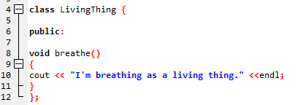
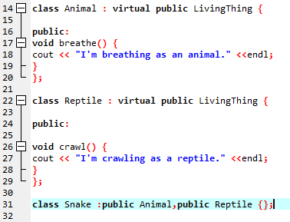
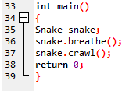
Solution..

Slide 28

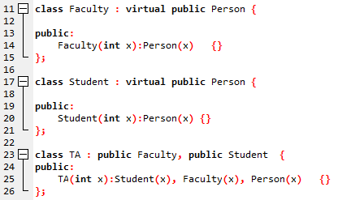

Diamond Problem Solution (With constructor)

Slide 29
Benefit of Virtual Inheritance
In general, it is not allowed to call the grandparent’s constructor directly, it has to be called through parent class. It is allowed only when ‘virtual’ keyword is used.
Calling Parameterized Constructor of Grandparent class
In this case we can call the parameterized constructor of grandparent class directly through grandchild class.

Slide 30
End

Slide 31
Operator Overloading
In C++, we make operators to work for user defined classes.
This means C++ has the ability to provide the operators with a special meaning for a data type, this ability is known as operator overloading.

Slide 32
Operator Overloading (Continue..)
For example, we can overload an operator ‘+’ in a class like String so that we can concatenate two strings by just using +
Other example classes where arithmetic operators may be overloaded are Complex Number, Fractional Number, Big Integer, etc.

Slide 33
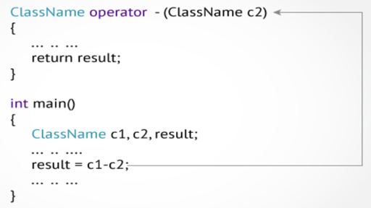
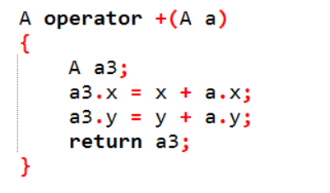
Operator Overloading (Continue..)
Overloaded operators are functions with special names: the keyword "operator" followed by the symbol for the operator being defined.

Slide 34
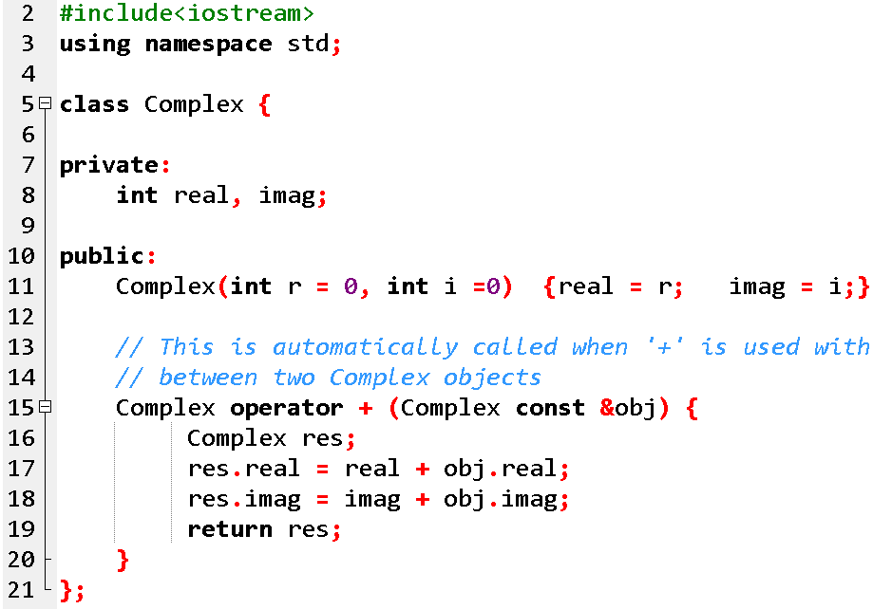
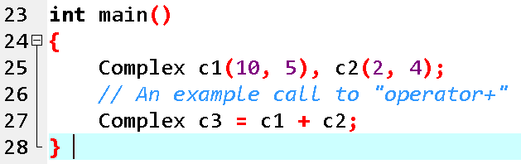
Operator Overloading (Continue..)

Slide 35
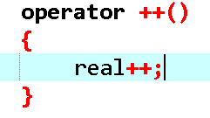
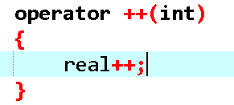
Operator Overloading
++object;
object++;

